Slide 1
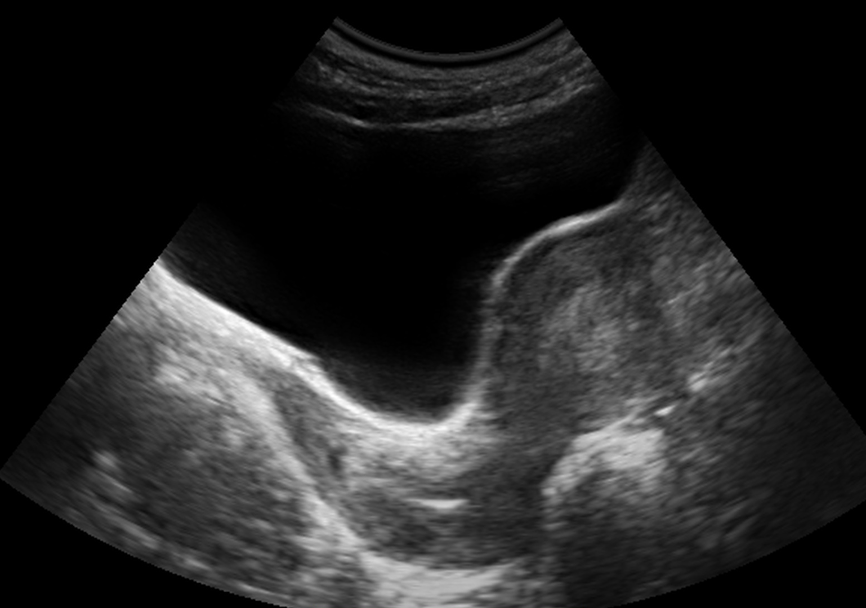
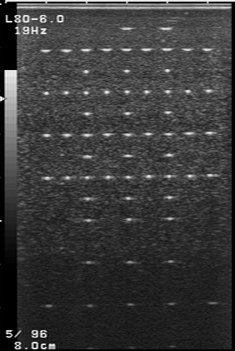
Ultrasound Imaging
Image Courtesy: S. A. Mason
Magnetic Resonance Imaging (MRI)
X-ray CT
PET

